Slide 1
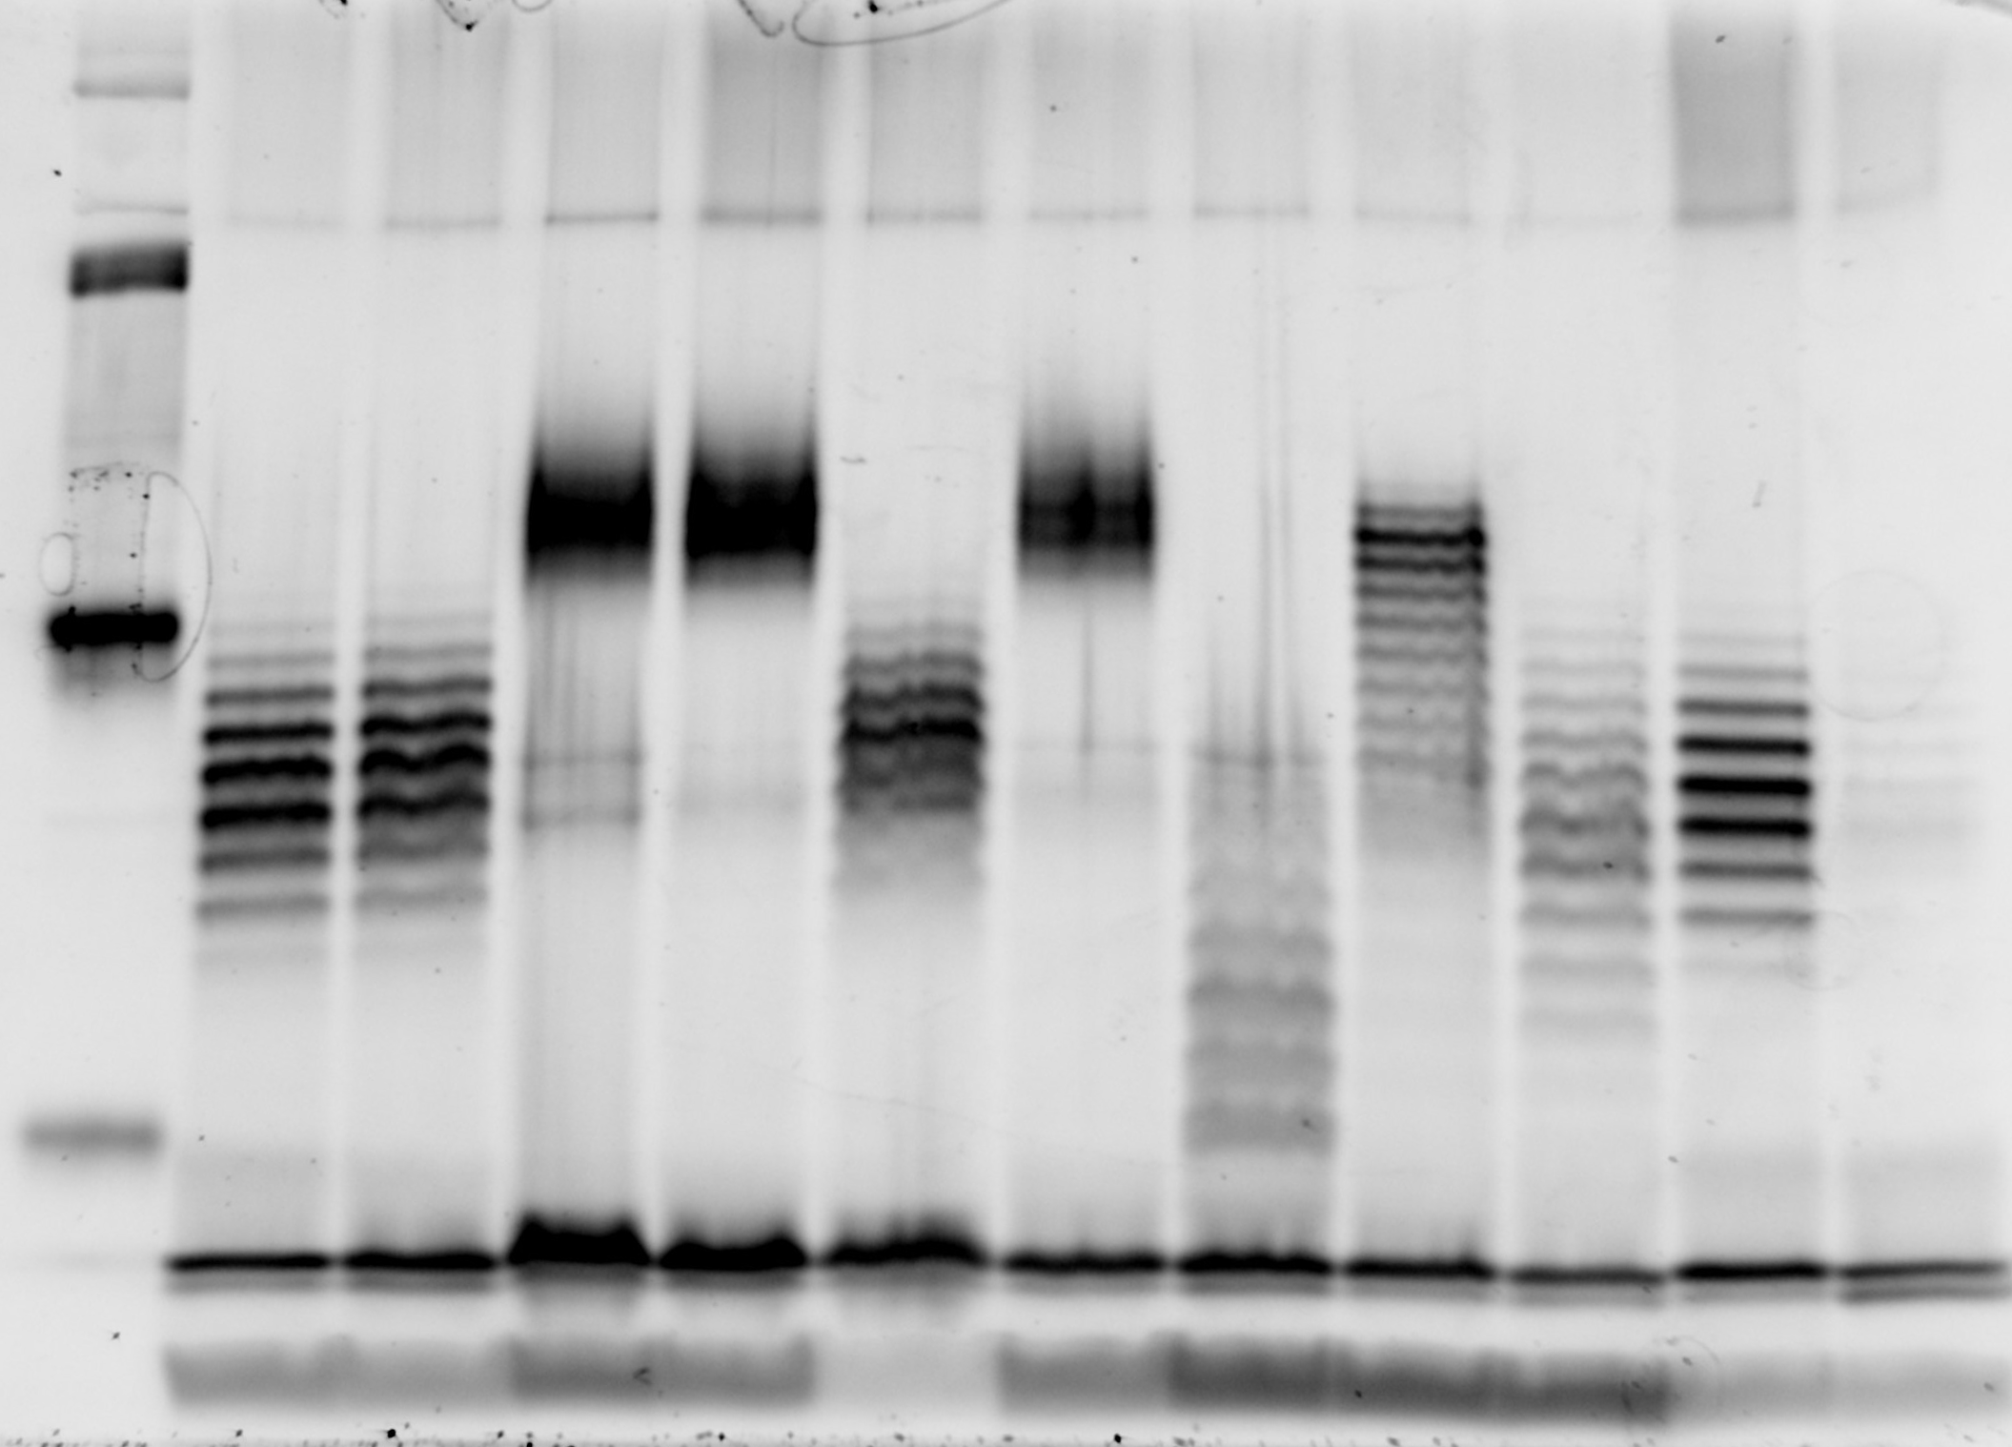
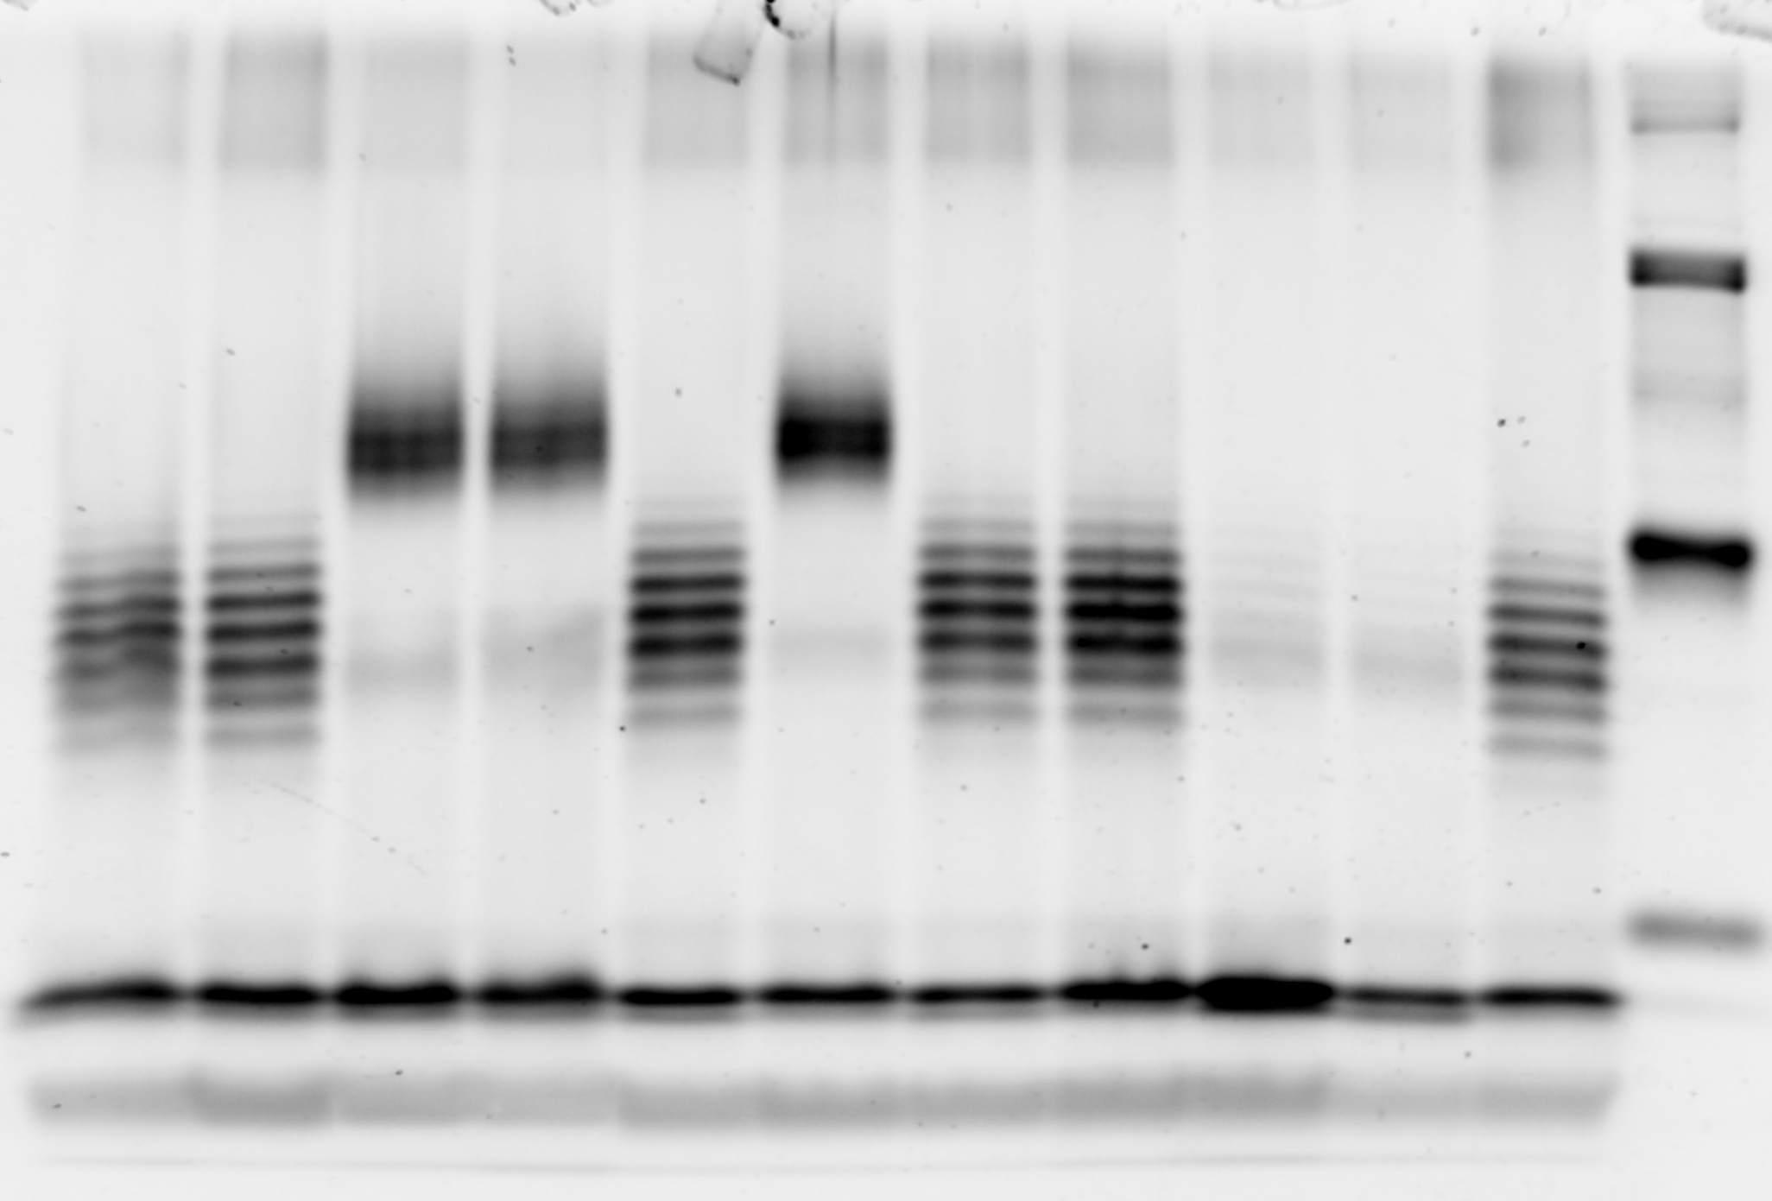
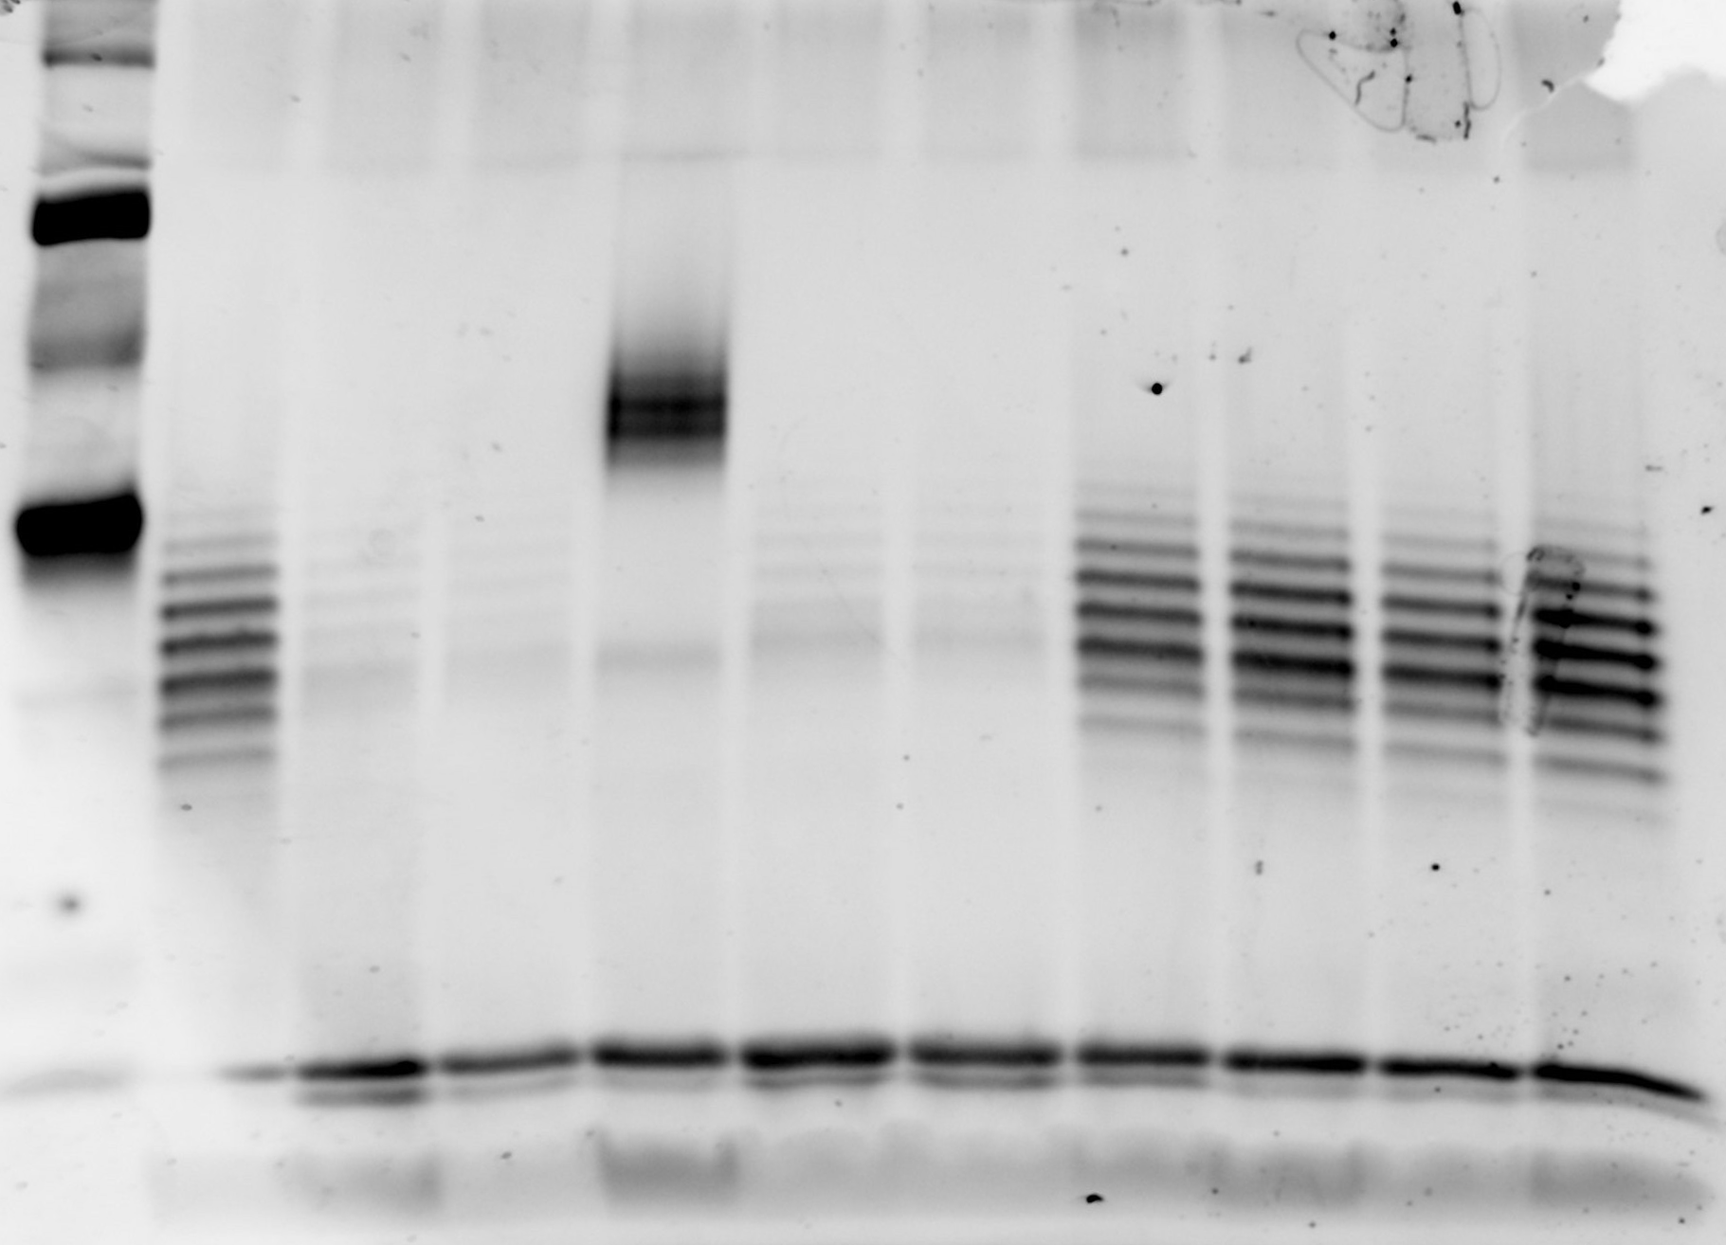
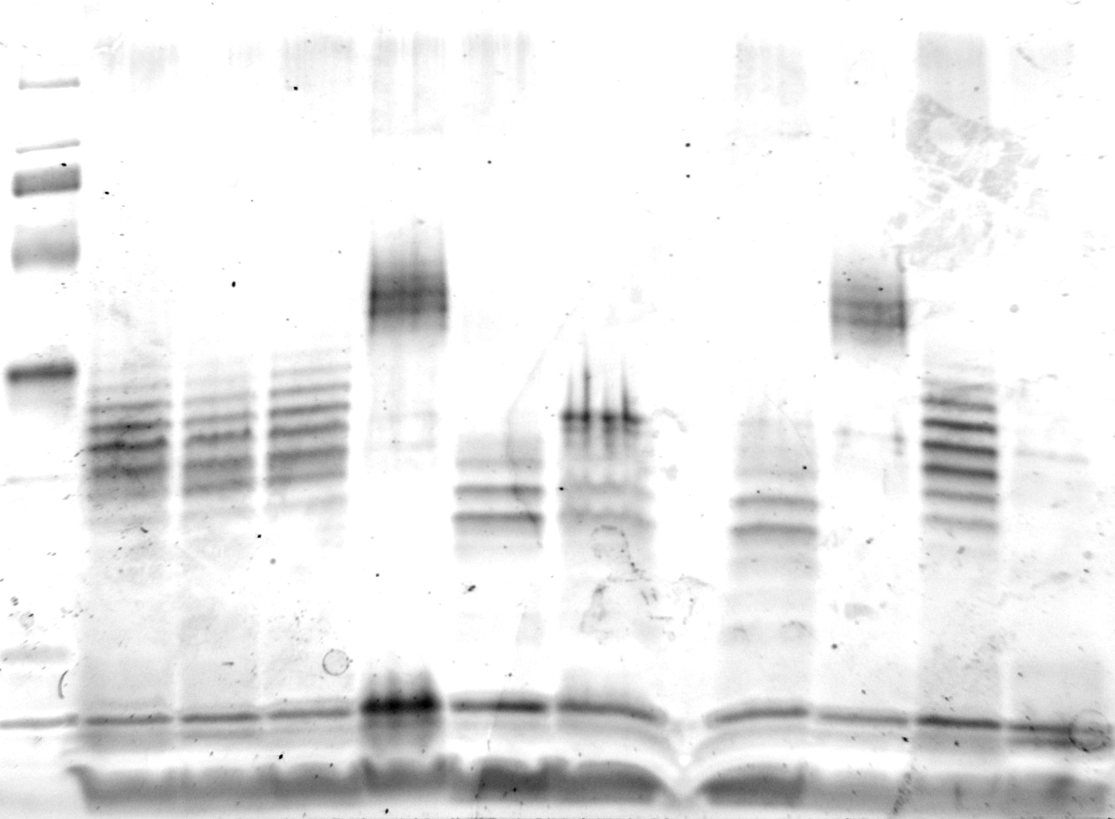
O-antigen “medium” genotype
(stop-codon reversion and +CGG insertion in BDAG_02328)
O-antigen “short” genotype
(stop-codon reversion, +CGG insertion, 525-550 aa SNP in BDAG_02321)
O-antigen “long” genotype
(stop-codon reversion)
Clade number or description:
2 3
Q-103 R-207
4
5
6
L544P
6
H548R
Q-103
Imaged on the same gel, included for LPS band comparison

Slide 2
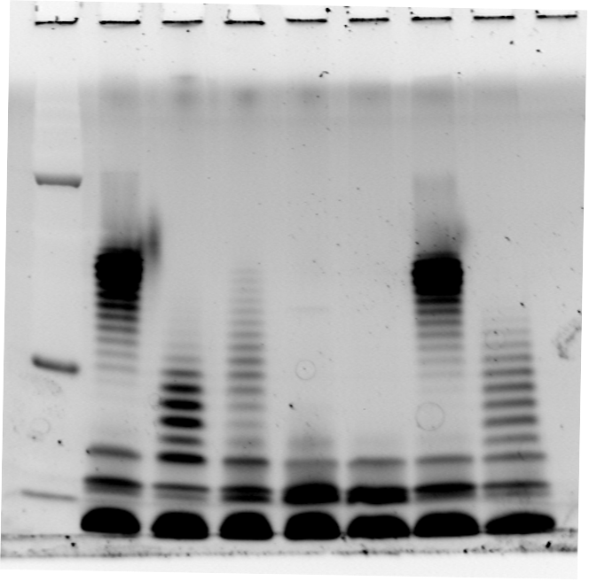
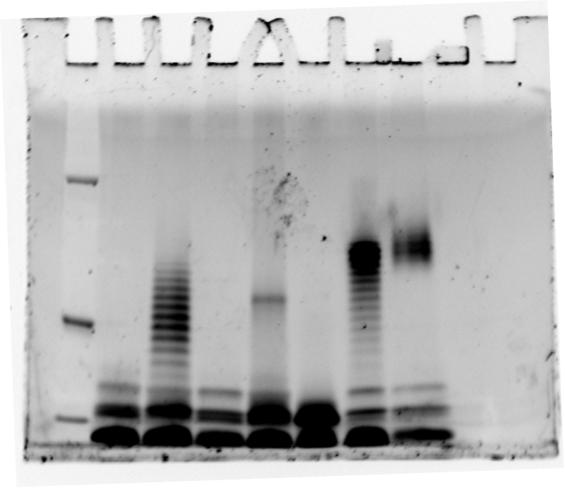
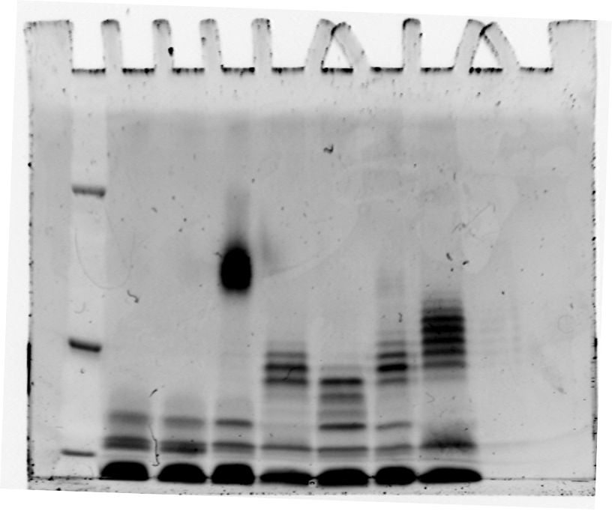
O-antigen “long” genotype
(contains stop-codon reversion)
O-antigen mutant genotypes
(stop-codon reversion and further
O-antigen synthesis gene mutations)
O-antigen absent genotype
(contains stop-codon in BDAG_02137)
Lieberman et al. 2011 gels
B-11-1 C-12-1 G-9-11b K-12-5 N-12-1
E-9-5 E-12-1 J-12-4 J-13-6a-$ J-14-2 J-14-8 K-12-8a-$ AU0158
A-0-0 C-10-0 F-6-9 F-6-11 G-9-8 I-9-6 K-10-0 M-9-4
Poret et al. 2023 gels
B-7-1 G-9-11b N-12-1
E-9-5 J-12-4 J-13-6a-$ J-14-2 K-15-5 AU0158

Slide 3
Full images
Cropped bands
Gel 1: A-0-0, AU0158, M-9-4, F-6-11, G-9-8, G-9-11b, C-12-1
Gel 2: B-11-1, E-9-5, E-12-1, C-10-0, K-10-0, K-12-5, K-12-8a-b
Gel 3: F-6-9, I-9-6, N-12-1, J-13-6a-b, J-14-2, J-14-8, J-12-4

